Slide 1








Evolving Web Design Assignment I
Off the Record
Responsive Website

Slide 2
Rationale & Personal Motivation
Off the Record Website
Peer controlled album review
Multi-Genre
Minimal indirect sponsorship
Music related
Formats
Technologically adept audience
Multiple platforms have to be catered for
Already have access to music
Stick to core functionality - Reviews

Slide 3
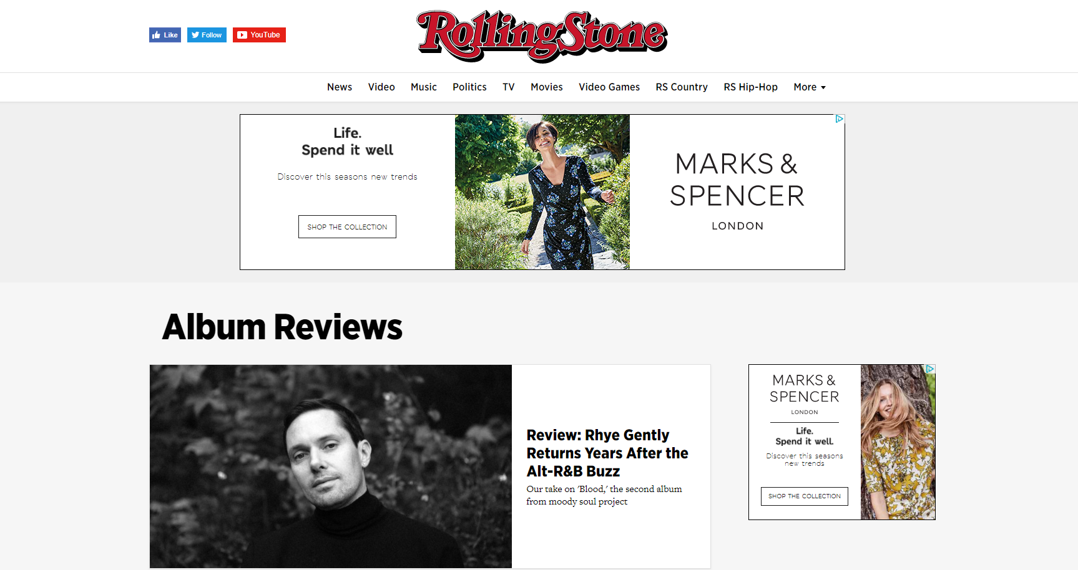
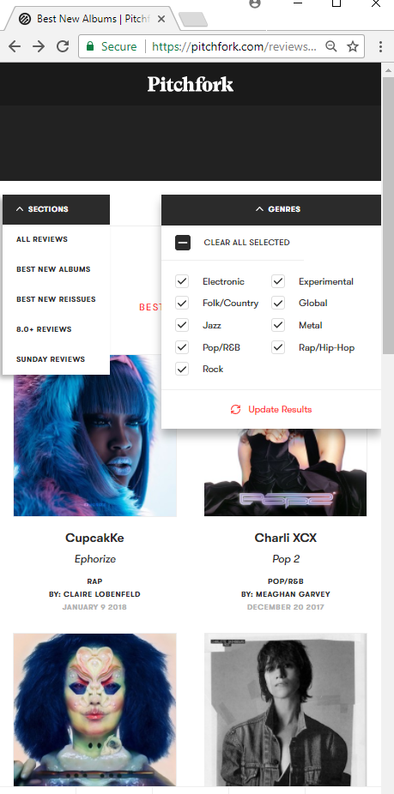
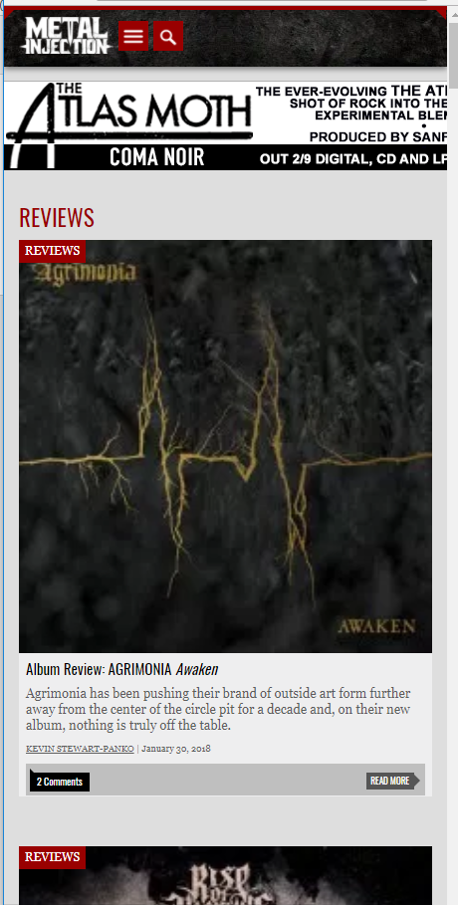
Research & Design Output
Current Review sites – SOA Survey
Pitchfork, Metal Injection, Rolling Stone
Different genres with different audiences …
… Followed standardised format
Little multimedia content
Universal responsive format
Sites adapted responsively - size and functionality
Colour schemes – Almost conservative … lets actual content shine
Use of empty space
Site Navigation
Advertising

Slide 4
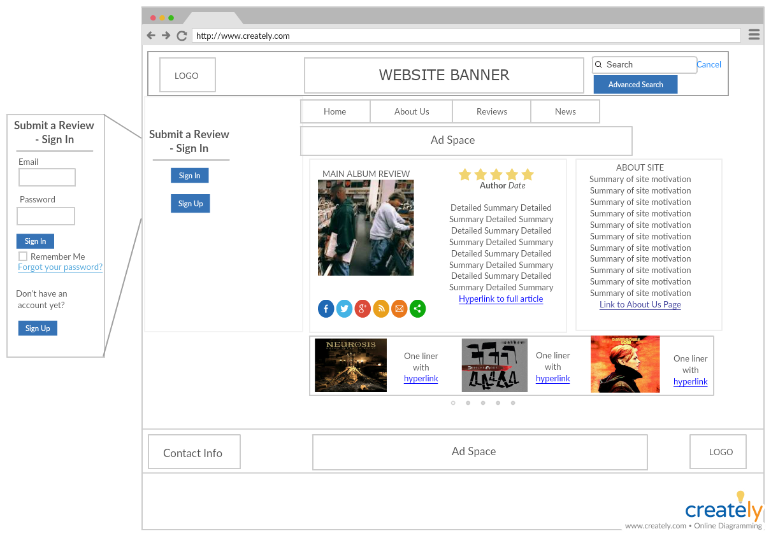

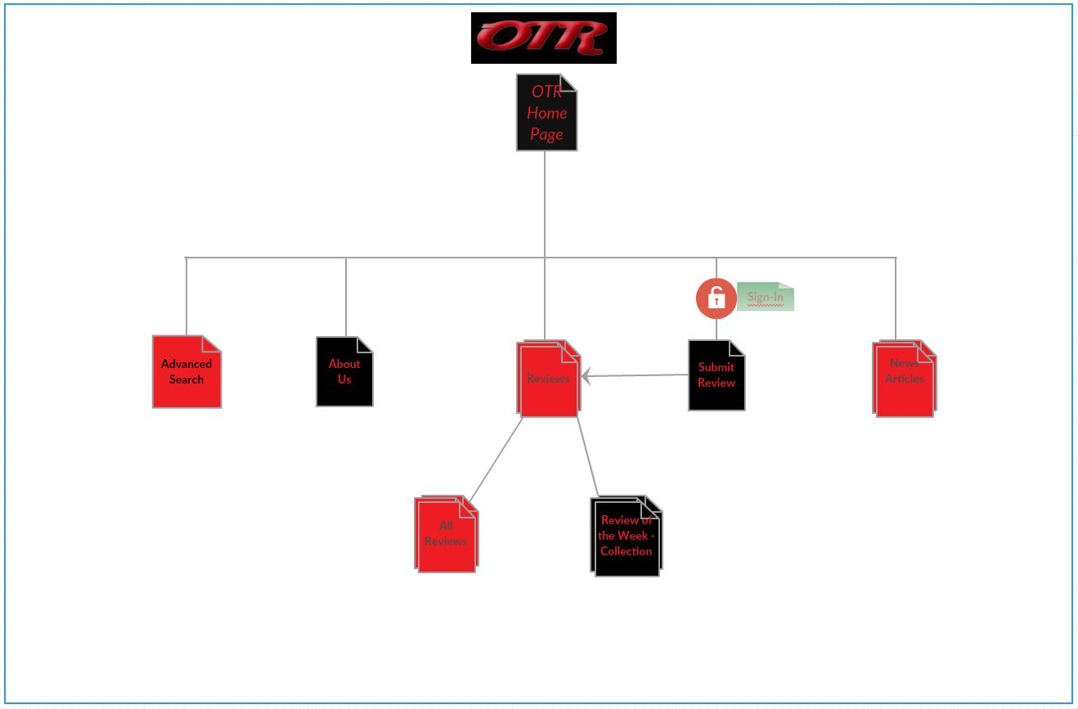
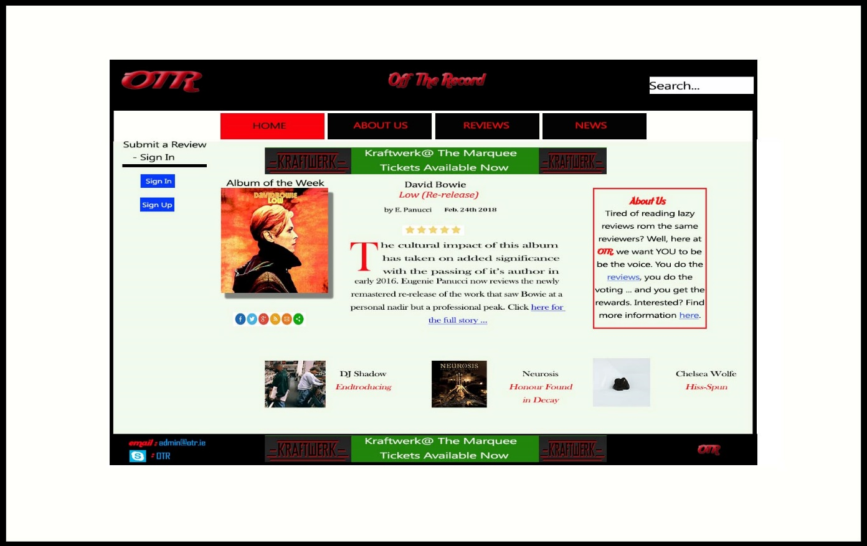
Research & Design Output II
Other observations
Logos
Text with some ornate formatting
Fonts
Only real distinction
Rock / Metal – Sans serif and more block
Generic – Serif
Conclusion & Output
Wireframes
Sitemap
Mock ups
While laborious, these were invaluable steps

Slide 5
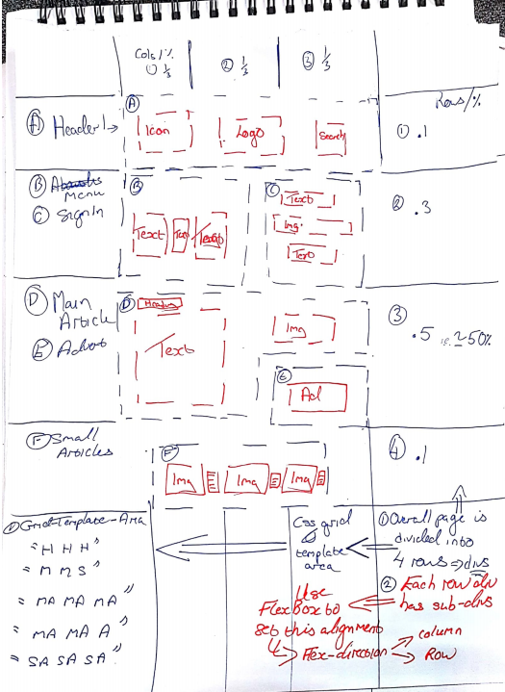
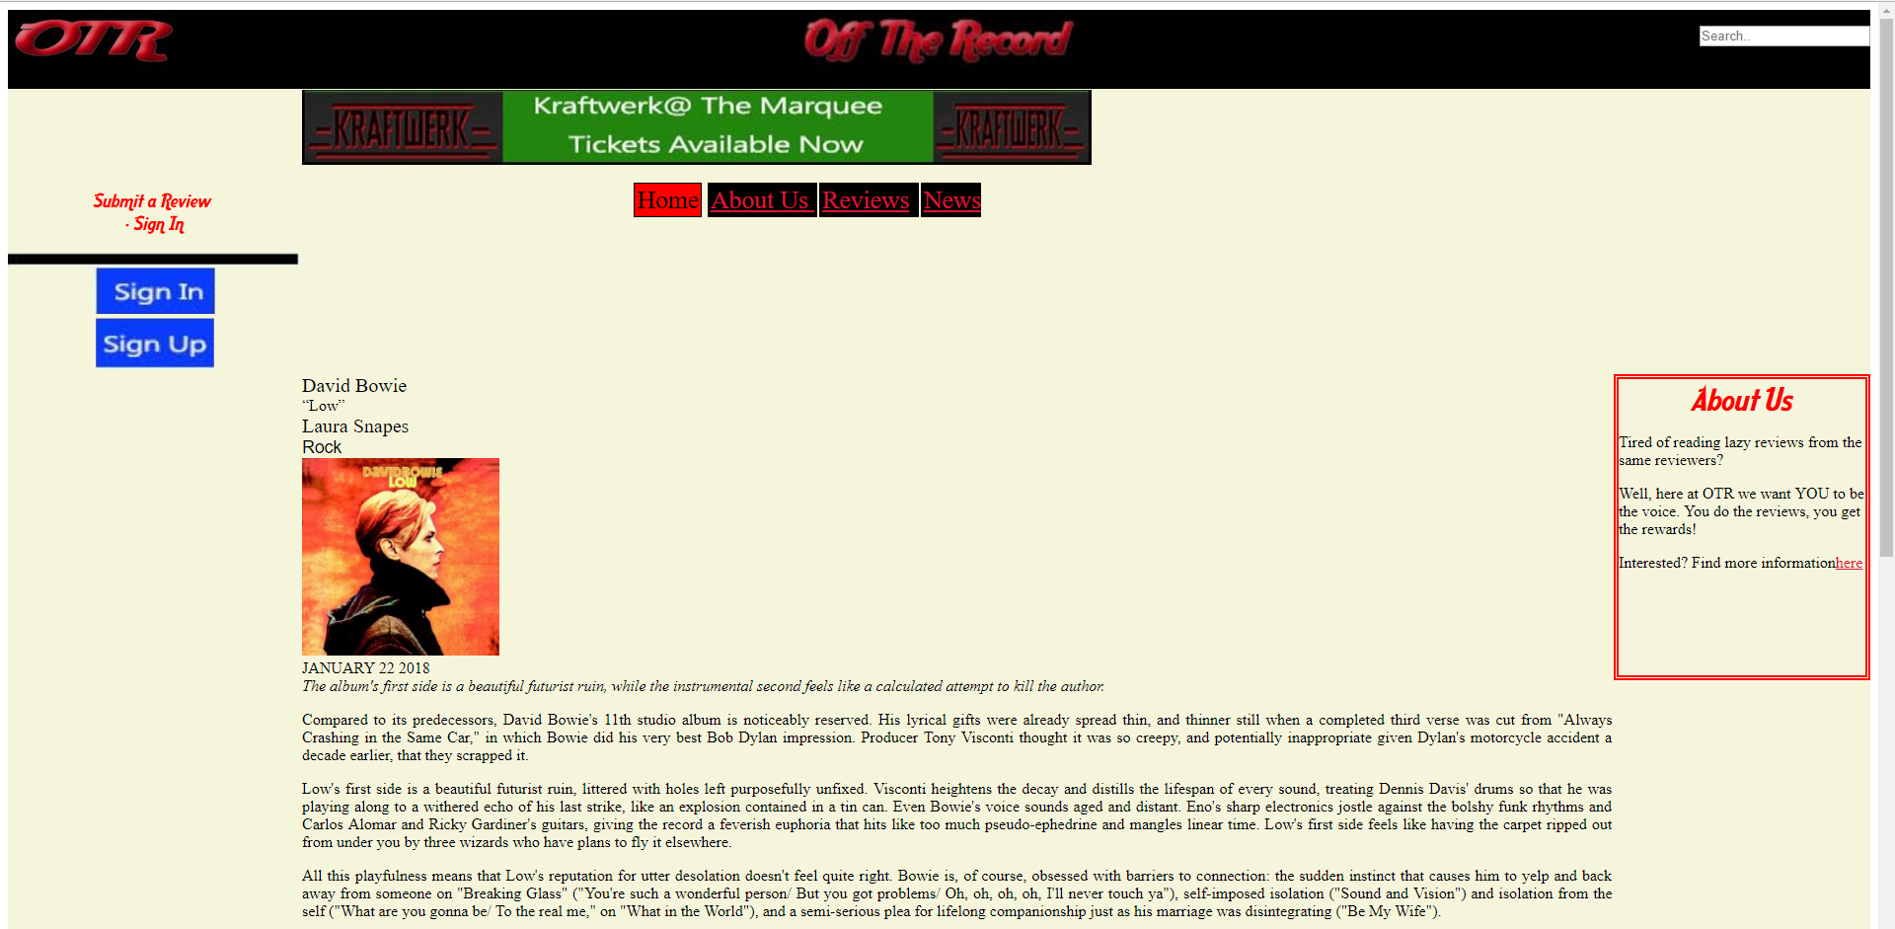
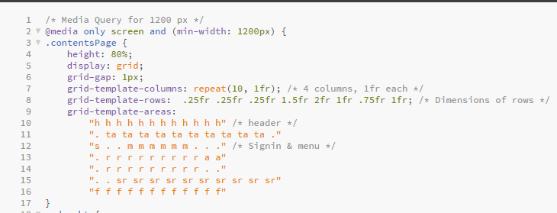
Development Process
Upskilling
YouTube, Scrimba courses
Practise
Get it wrong ➔ Repeat ➔ Get it right ➔ Repeat
Modularise
Every page has a basic overall structure ➔ divs
Header, Top Advert, Sign – In, About Us, Small Reviews, Bottom Advert, Footer
Contained sub-divs
Dynamic section
Main article div ➔ Changed with page content

Slide 6
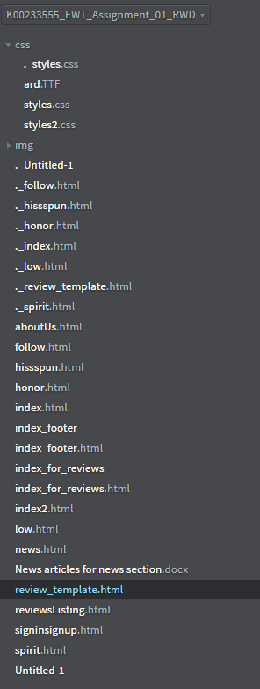
Development Process II
Responsiveness
Mixture of
CSS Grid (Overall Page)
FlexBox (Individual Sections)
Experimentation
Create divs with dummy information
Populated once correct
CSS – Size & Display
Size of elements altered per media query (4)
1200, 800, 540, 380
Hide / unhide divs as needed
Dropdown menu / Menu bar
Conventions
File & tag names

Slide 7


Development Process III
Is the site perfect?
NO
Could be more responsive
4 breakpoints
Could be more unique
Could have more …
Social media content
Streaming content (BandCamp)
But …
It is like your favourite albums
Definitely scratched!
Overall sleeve a bit torn in places
Not everyone else likes it!
Probably not available or suited to all formats
… but irrespective of whatever else you listen to, you’ll always love hearing it again

Slide 8

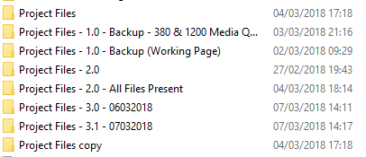
Lessons Learnt
Point of the exercise
Negatives – Learn from
Learning curve – Factor in
Remit – Clarity
Positives – Improve upon
It is the little things that matter
Planning & Documentation – Even if its only on paper!
CamScanner
Structured approach – Get 1 page working, use as basic template
Seek help
Technical Questions
Reviewing
Input
Go Viking – Burn the ship if needed, but versioning helps avoid this
Switch to NetBeans for FYP
Balanced approach – Needed if combining two competing / complementary frameworks
Focus on the smallest elements and work upwards - FlexBox
VS
Focus on the larger element and work downwards – CSS Grid

Slide 9
Links
Off the Record Website
GitHub repository
Other sites
YouTube video of CSS vs FlexBox
Scrimba

Slide 10
Thanks
Sean O’Regan
Ciprian Tudose
Mitchell O’Regan
Ashling Berman
Class Colleagues
And of course … the Magnificent 8 ☺

